Slide 1





Geometric Static Modeling Framework for Piecewise-Continuous Curved-Link Multi Point-of-Contact Tensegrity Robots
Lauren Ervin and Vishesh Vikas
Agile Robotics Laboratory
arl.ua.edu
The University of Alabama, USA

Slide 2
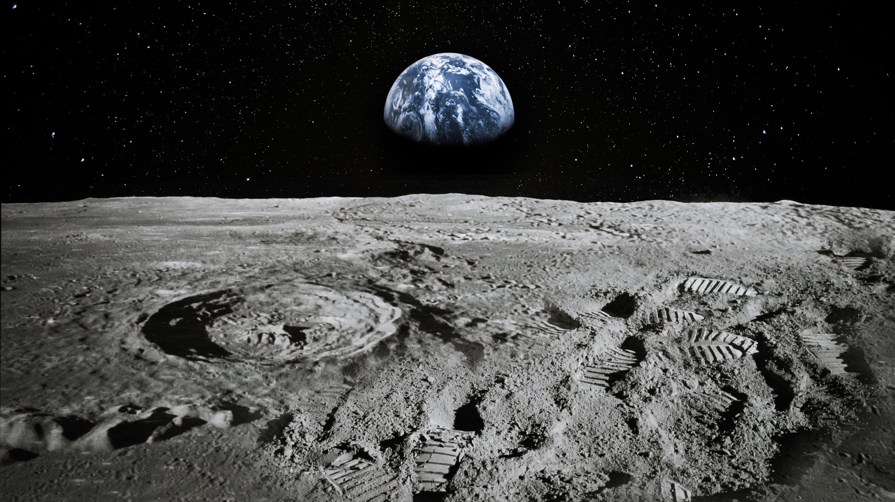
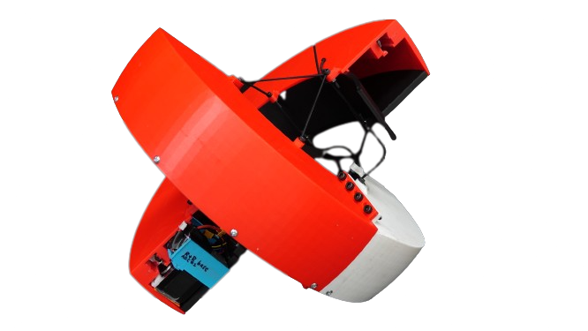

Motivation
Discontinuous, curved morphology well suited for space applications

Slide 3
Critical Terminology
Tensegrity mechanism – Synergistically combine tension elements (pre-stressed cables) with compression elements (rigid rods) to achieve structural integrity
Screw Theory– Framework used to geometrically model motion of rigid bodies as twists along a screw axis
Hybrid system – The robot moves in four different states: it always rolls along the entirety of one arc while pivoting about an endpoint of the other until swapping arcs
Piecewise continuous movement – Rolling produces continuous movement in different directions that instantaneously flip when updating pivot points; when combined, the movement generates a straight path
Stability – A robot orientation where tip-over does not occur regardless of internal mass positions

Slide 4
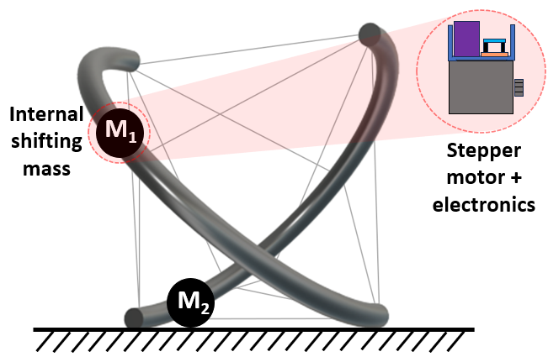
Tensegrity eXploratory Robot (TeXploR) Design
Curved-links with two points of contact

Slide 5
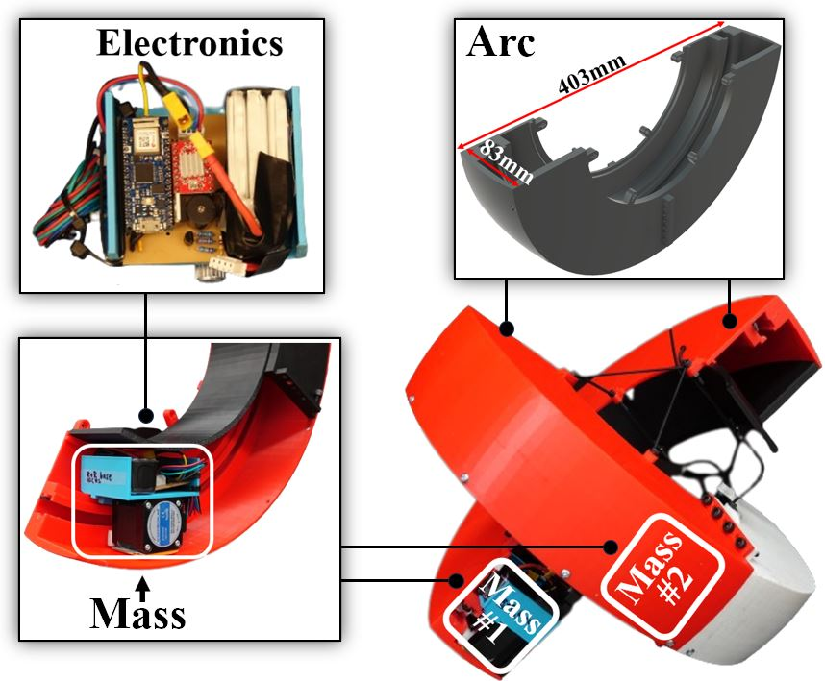
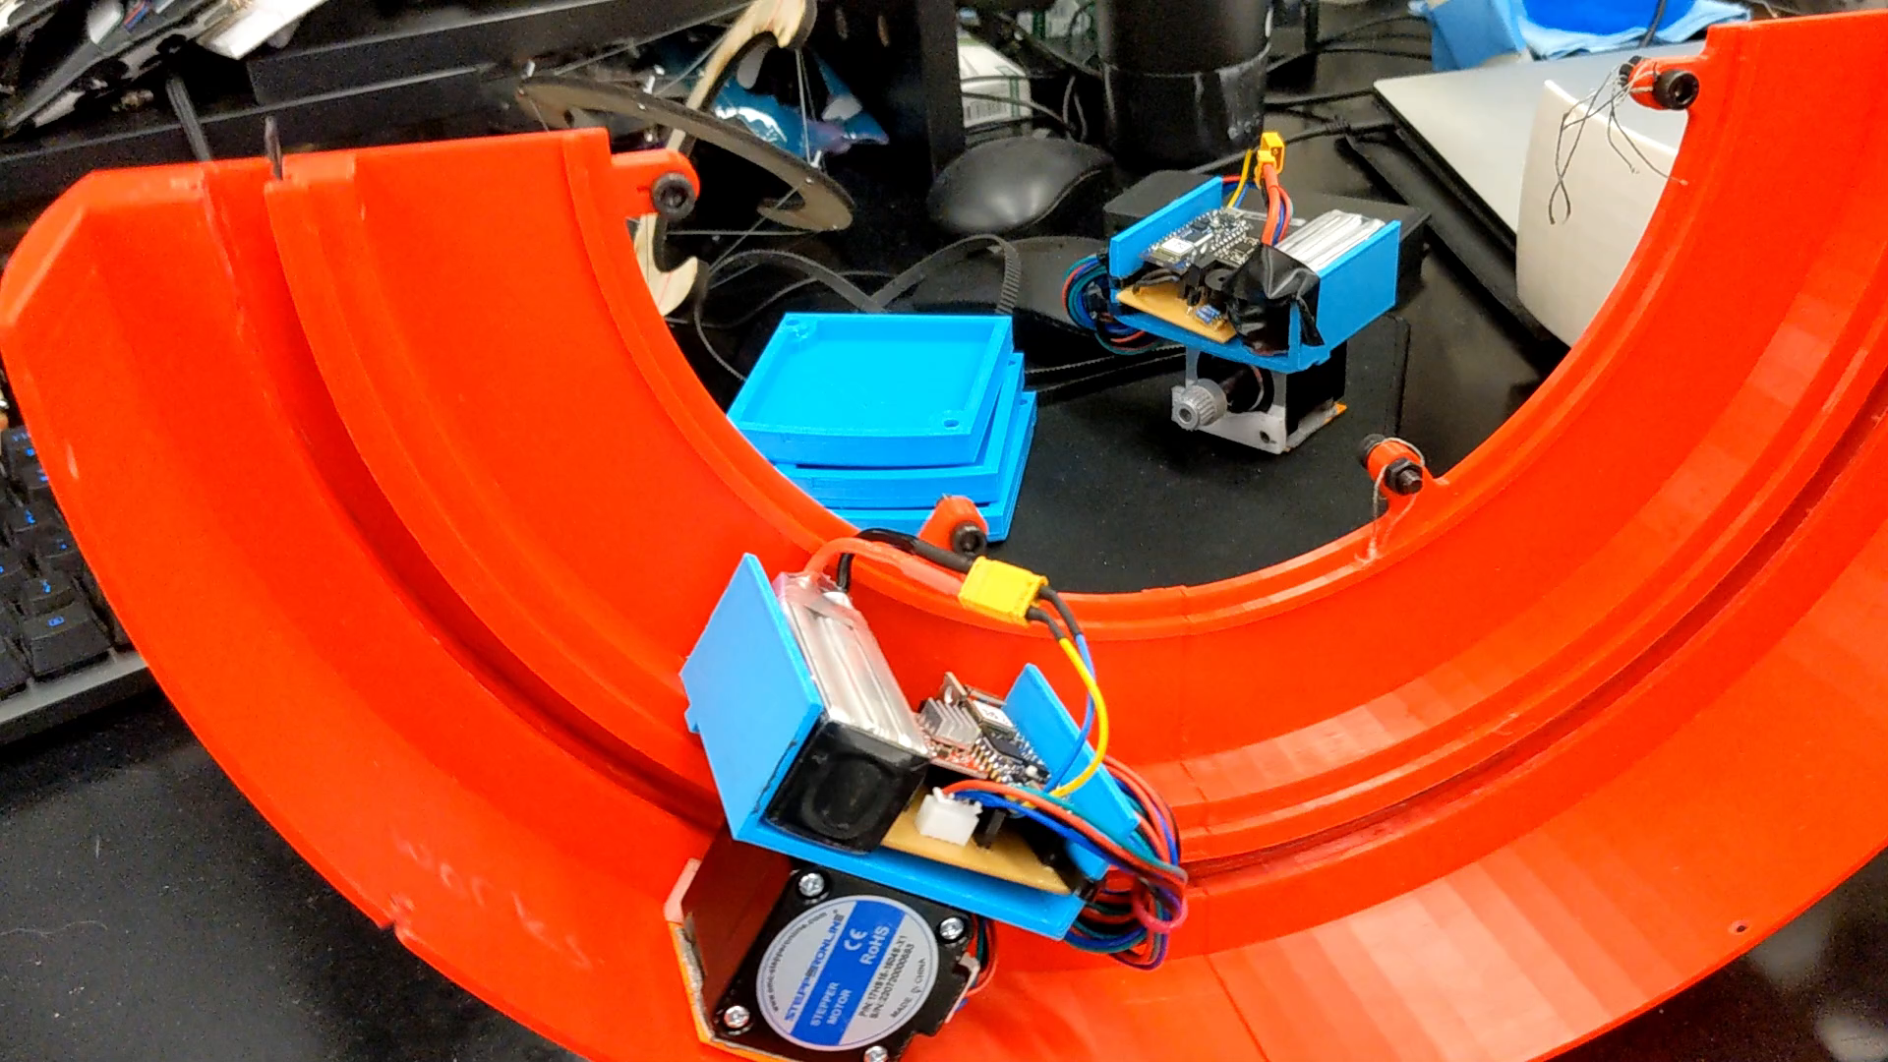
TeXploR Prototype Mechatronics
All electronics mounted internally and shift along arc
Internal Mass Shifting

Slide 6
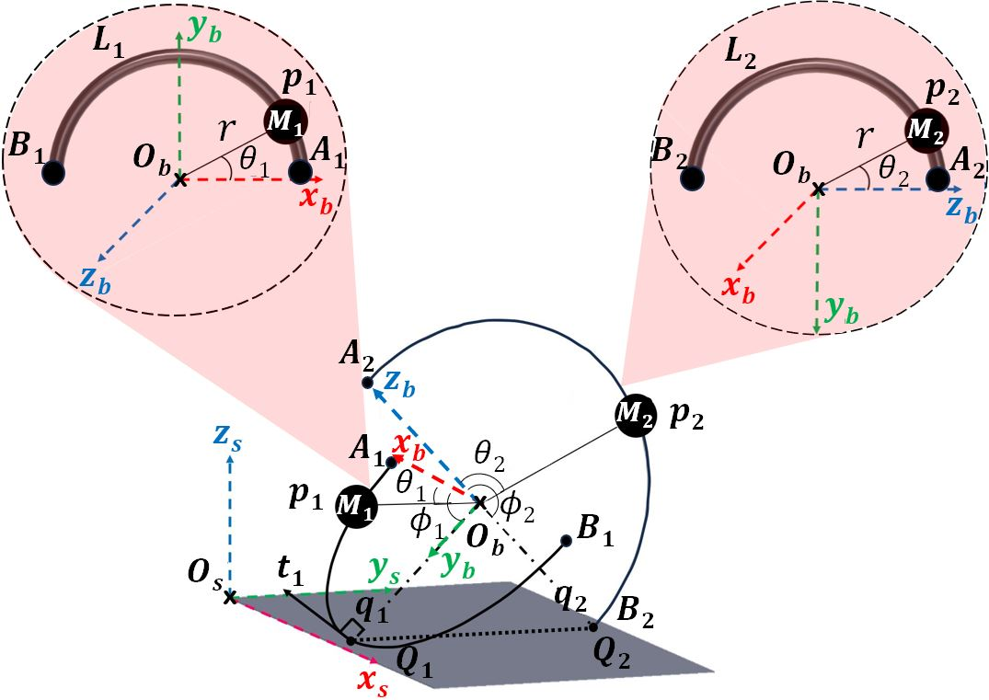
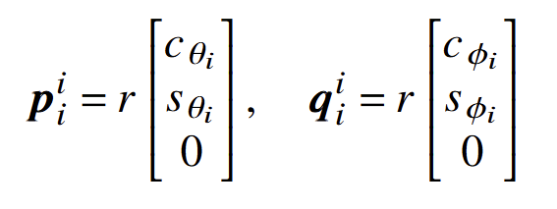
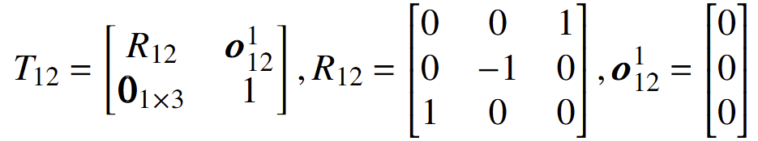
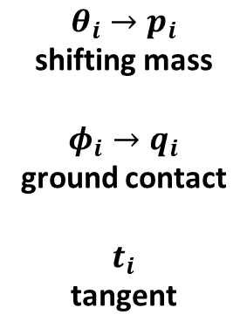
Kinematics
Geometric representation using Screw Theory
$$θ_{i}→p_{i}$$
shifting mass
$$φ_{i}→q_{i}$$
ground contact
$$t_{i}$$
tangent

Slide 7
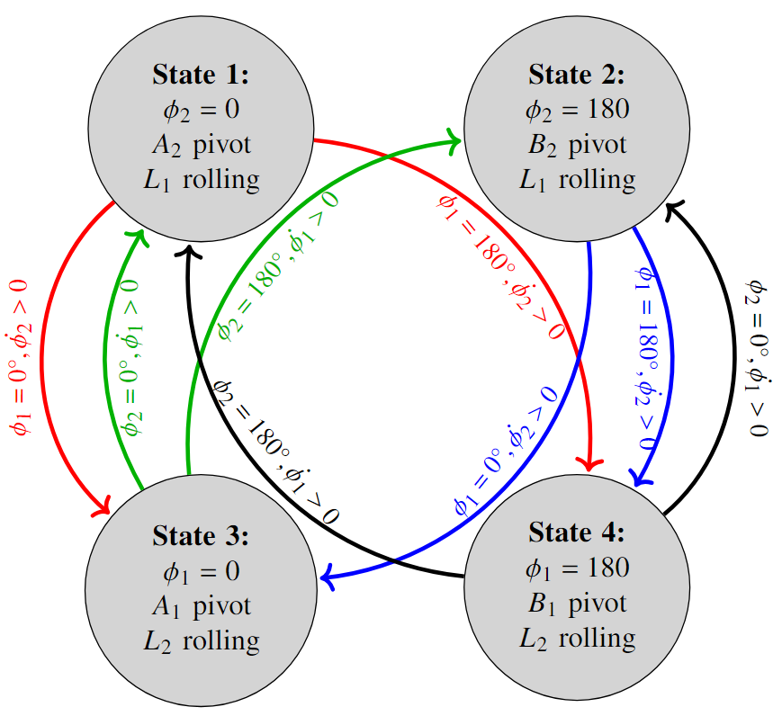
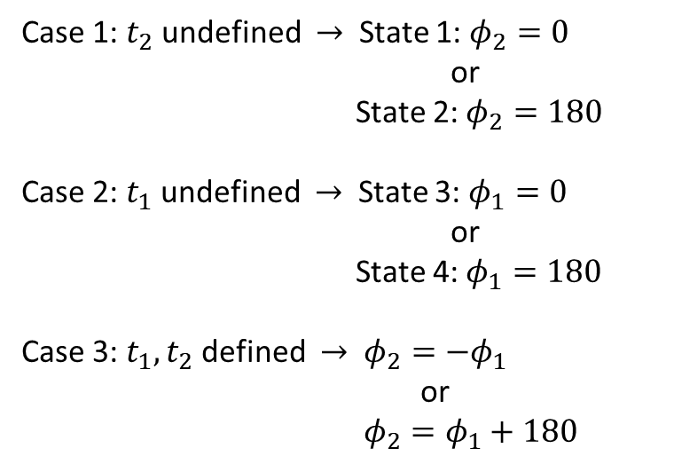
Hybrid State System
Four states of locomotion for rolling sequence from holonomic constraints
Case 1: $t_{2}$ undefined $→$ State 1: $φ_{2}=0$
or
State 2: $φ_{2}=180$
Case 2: $t_{1}$ undefined $→$ State 3: $φ_{1}=0$
or
State 4: $φ_{1}=180$
Case 3: $t_{1}, t_{2}$ defined $→$ $φ_{2}=−φ_{1}$
or
$φ_{2}=φ_{1}+180$

Slide 8
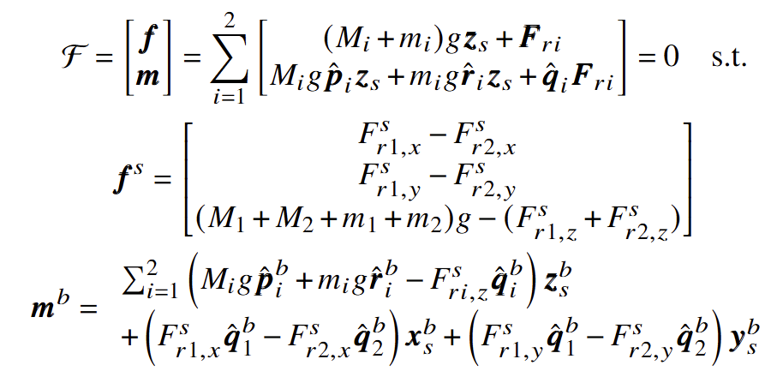
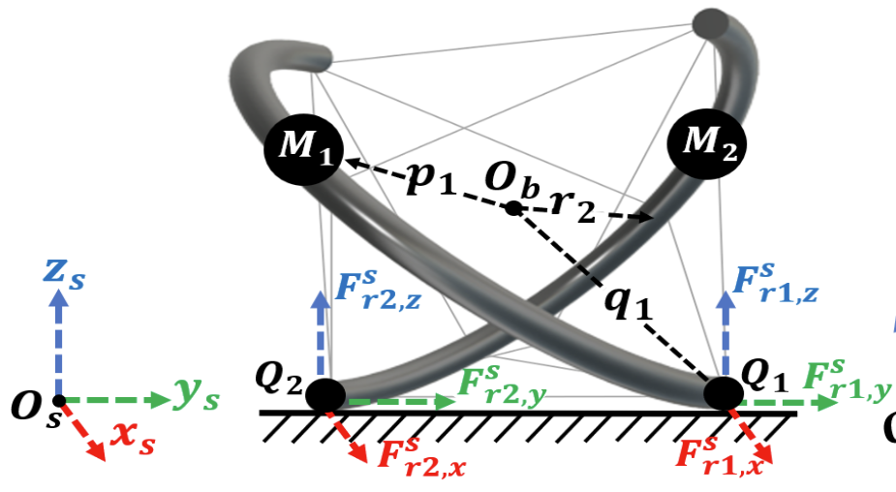
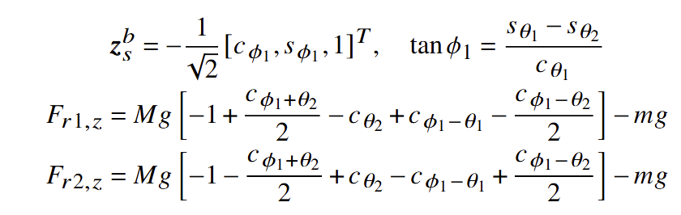
Geometric Static Modeling Framework
Internal mass inputs → static equilibrium position output
Holonomic constraints
...
State 1
State 4
Hybrid system

Slide 9
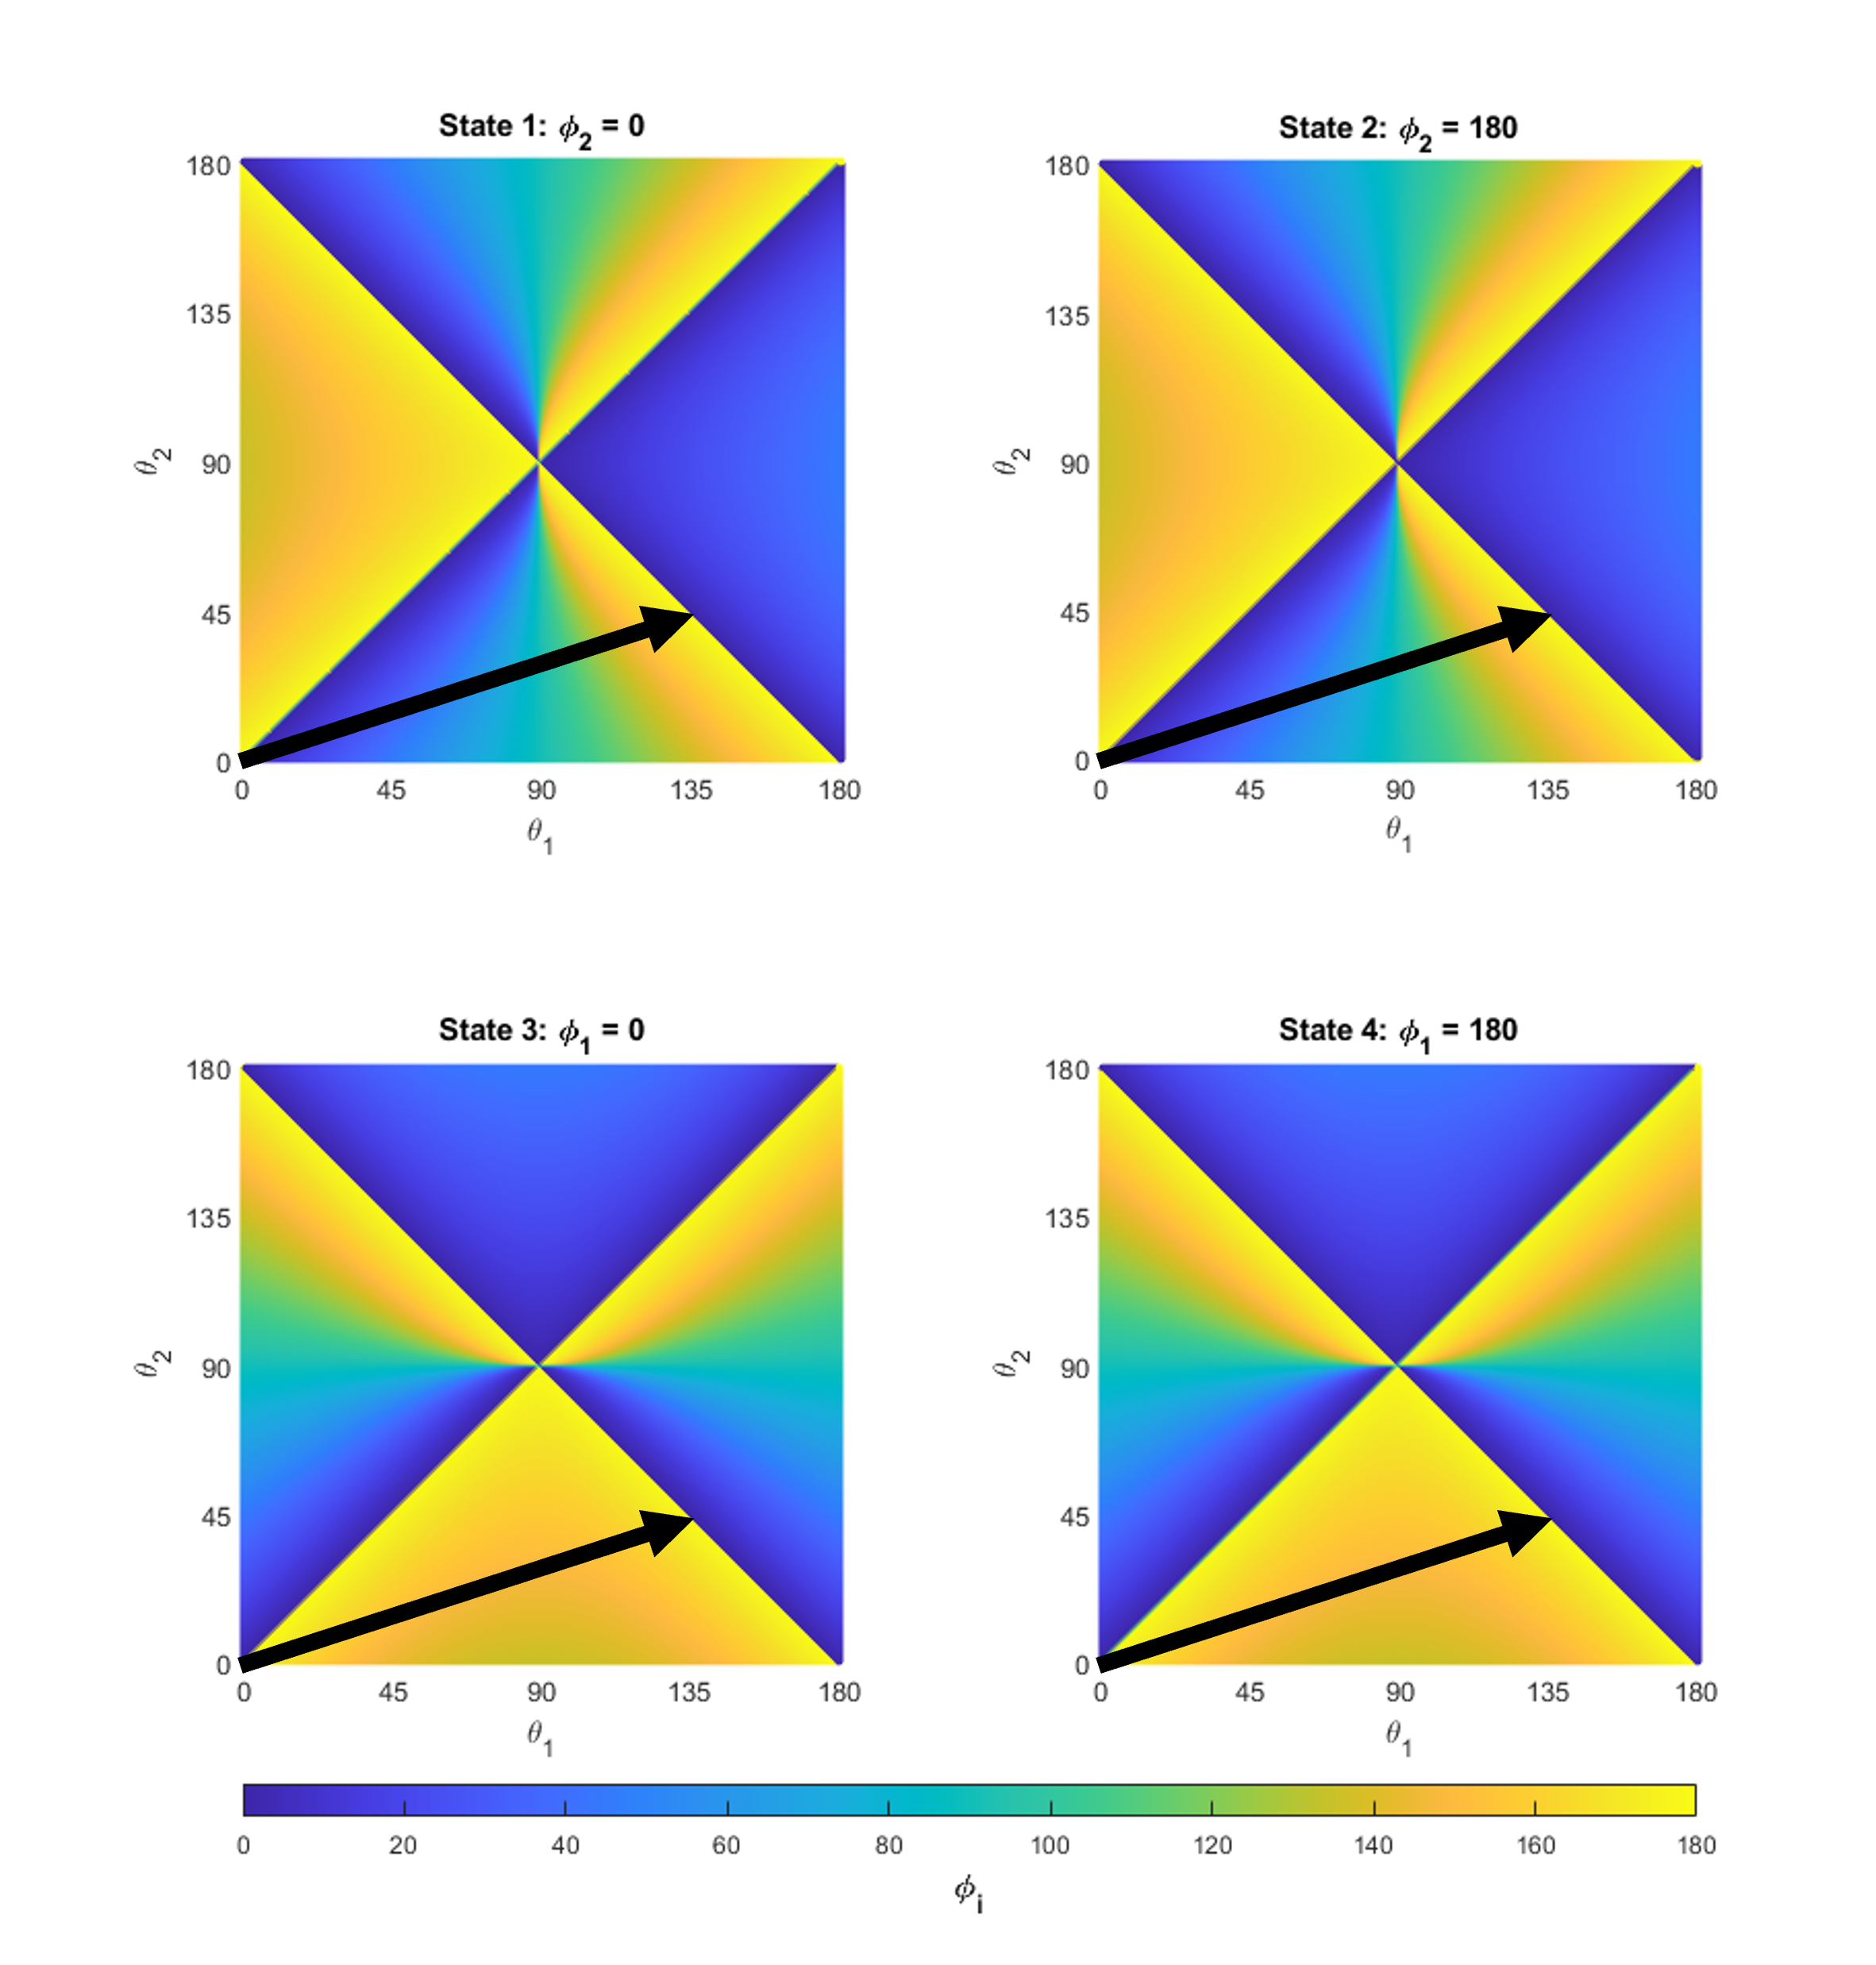
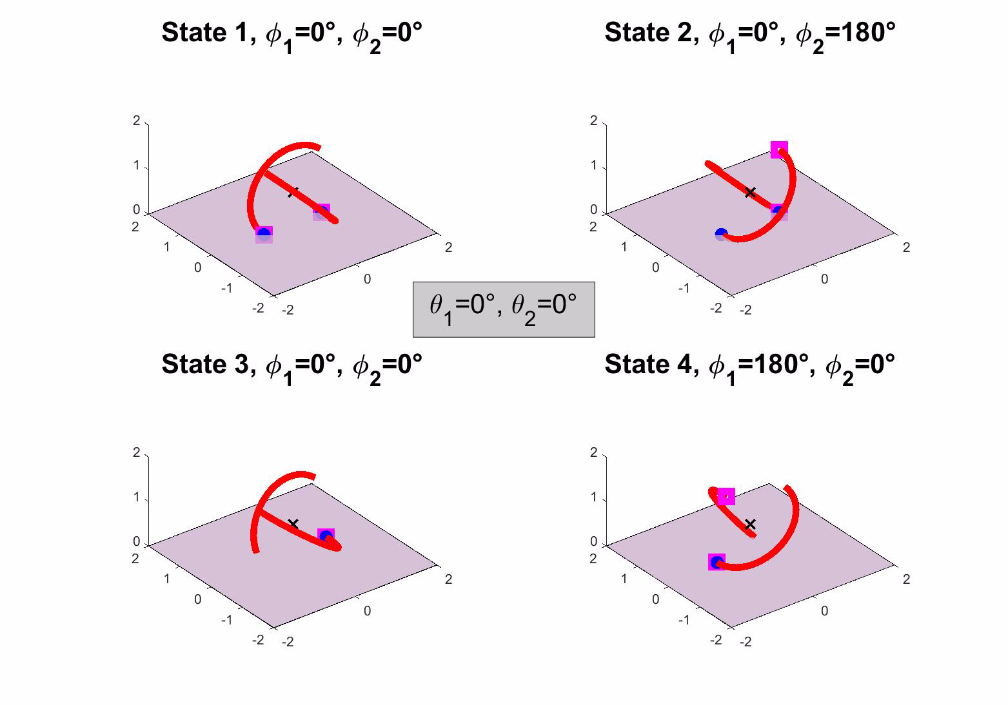
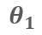
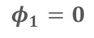
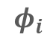
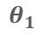
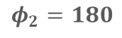
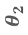
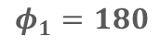
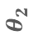
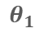
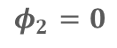
Quasi-Static Simulations
State 1:
$$φ_{2}=0$$
State 2:
$$φ_{2}=180$$
180
135
90
45
0
180
135
90
45
0
180
135
90
45
0
180
135
90
45
0
$$θ_{2}$$
$$θ_{2}$$
0 45 90 135 180 0 45 90 135 180
$$θ_{1}$$
$$θ_{1}$$
State 3:
$$φ_{1}=0$$
State 4:
$$φ_{1}=180$$
$$θ_{2}$$
$$θ_{2}$$
0 45 90 135 180 0 45 90 135 180
$$θ_{1}$$
$$θ_{1}$$
0 20 40 60 80 100 120 140 160 180
$$φ_{i}$$

Slide 10
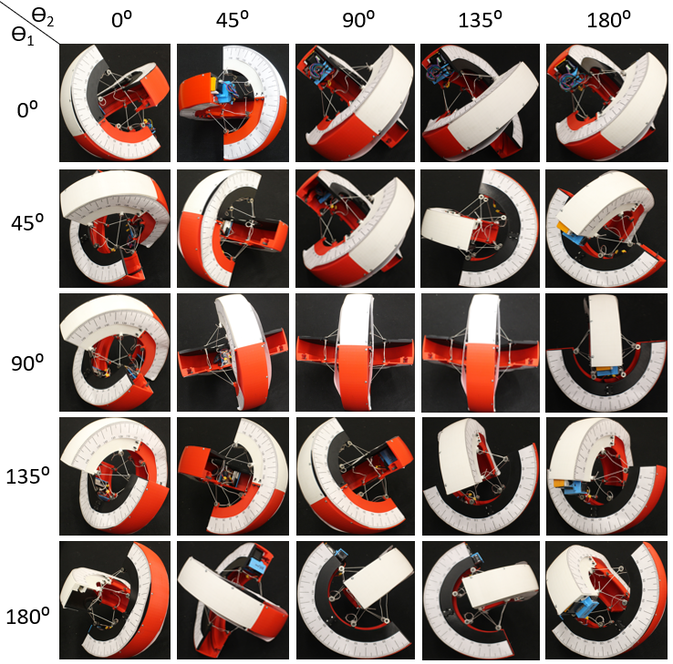
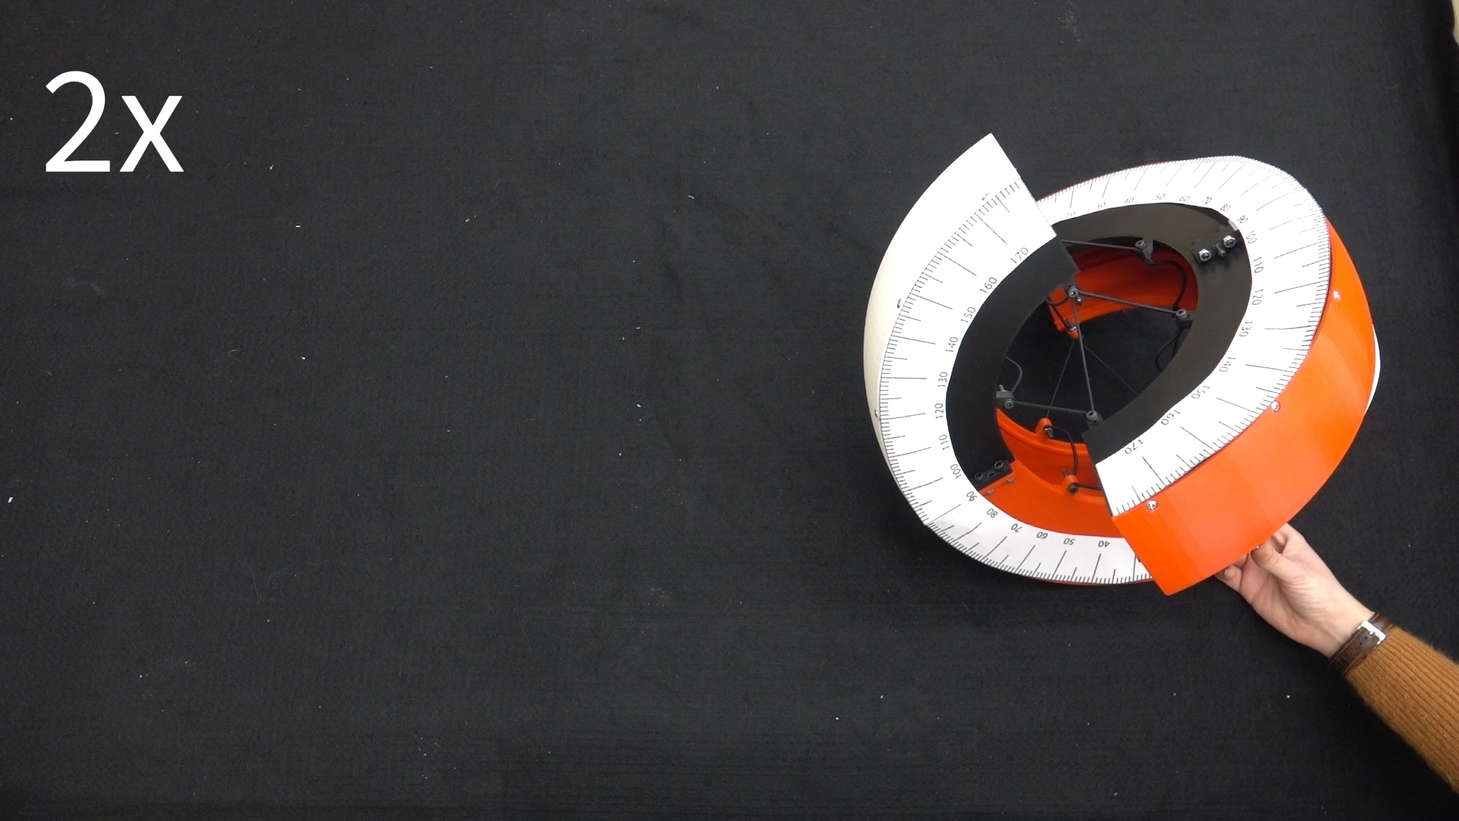
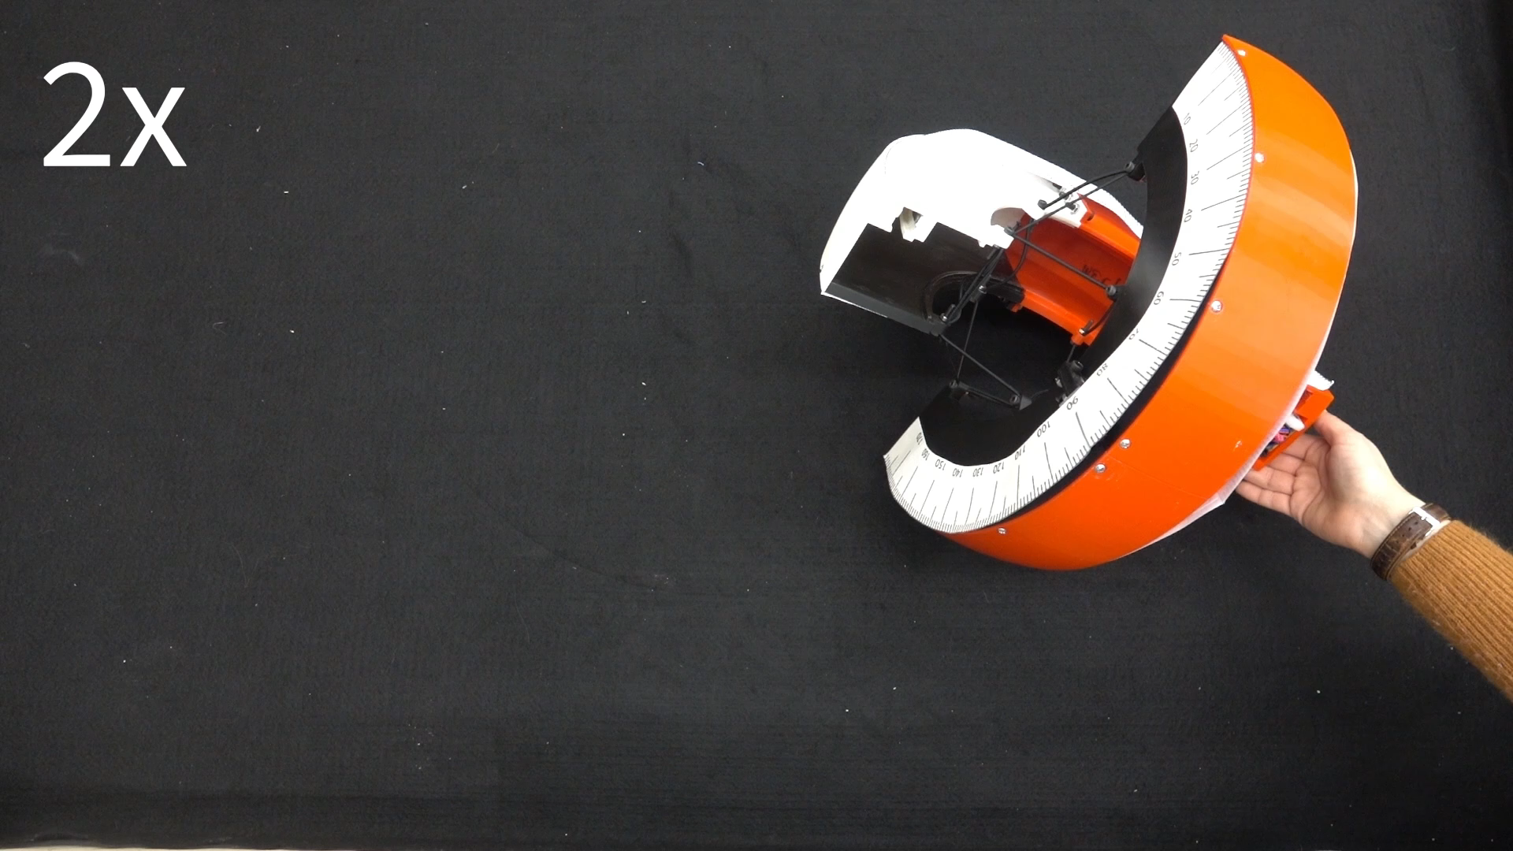
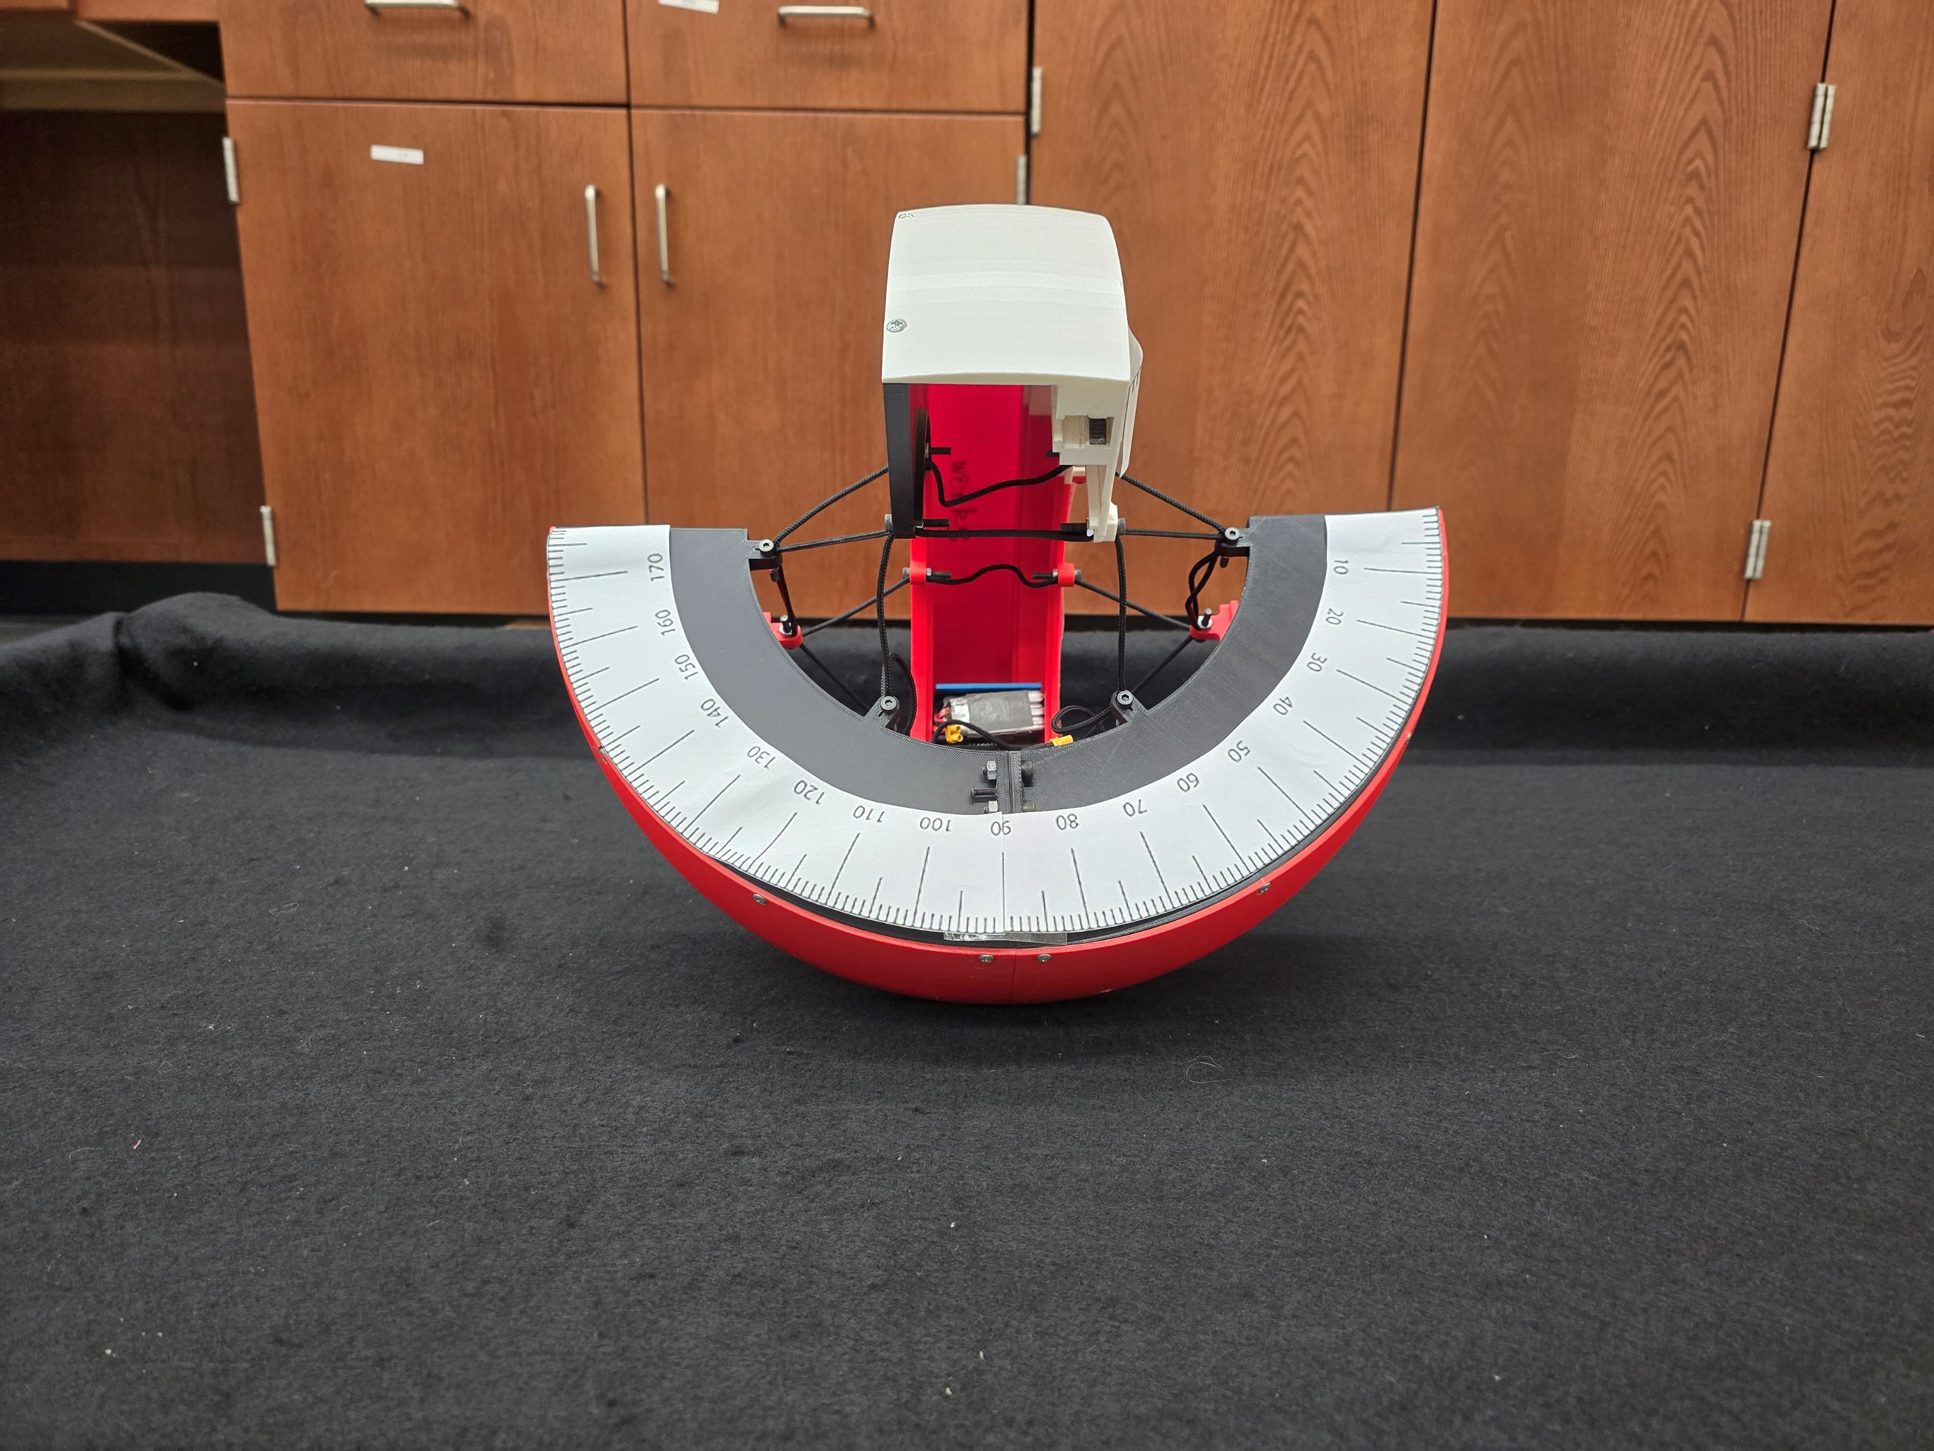
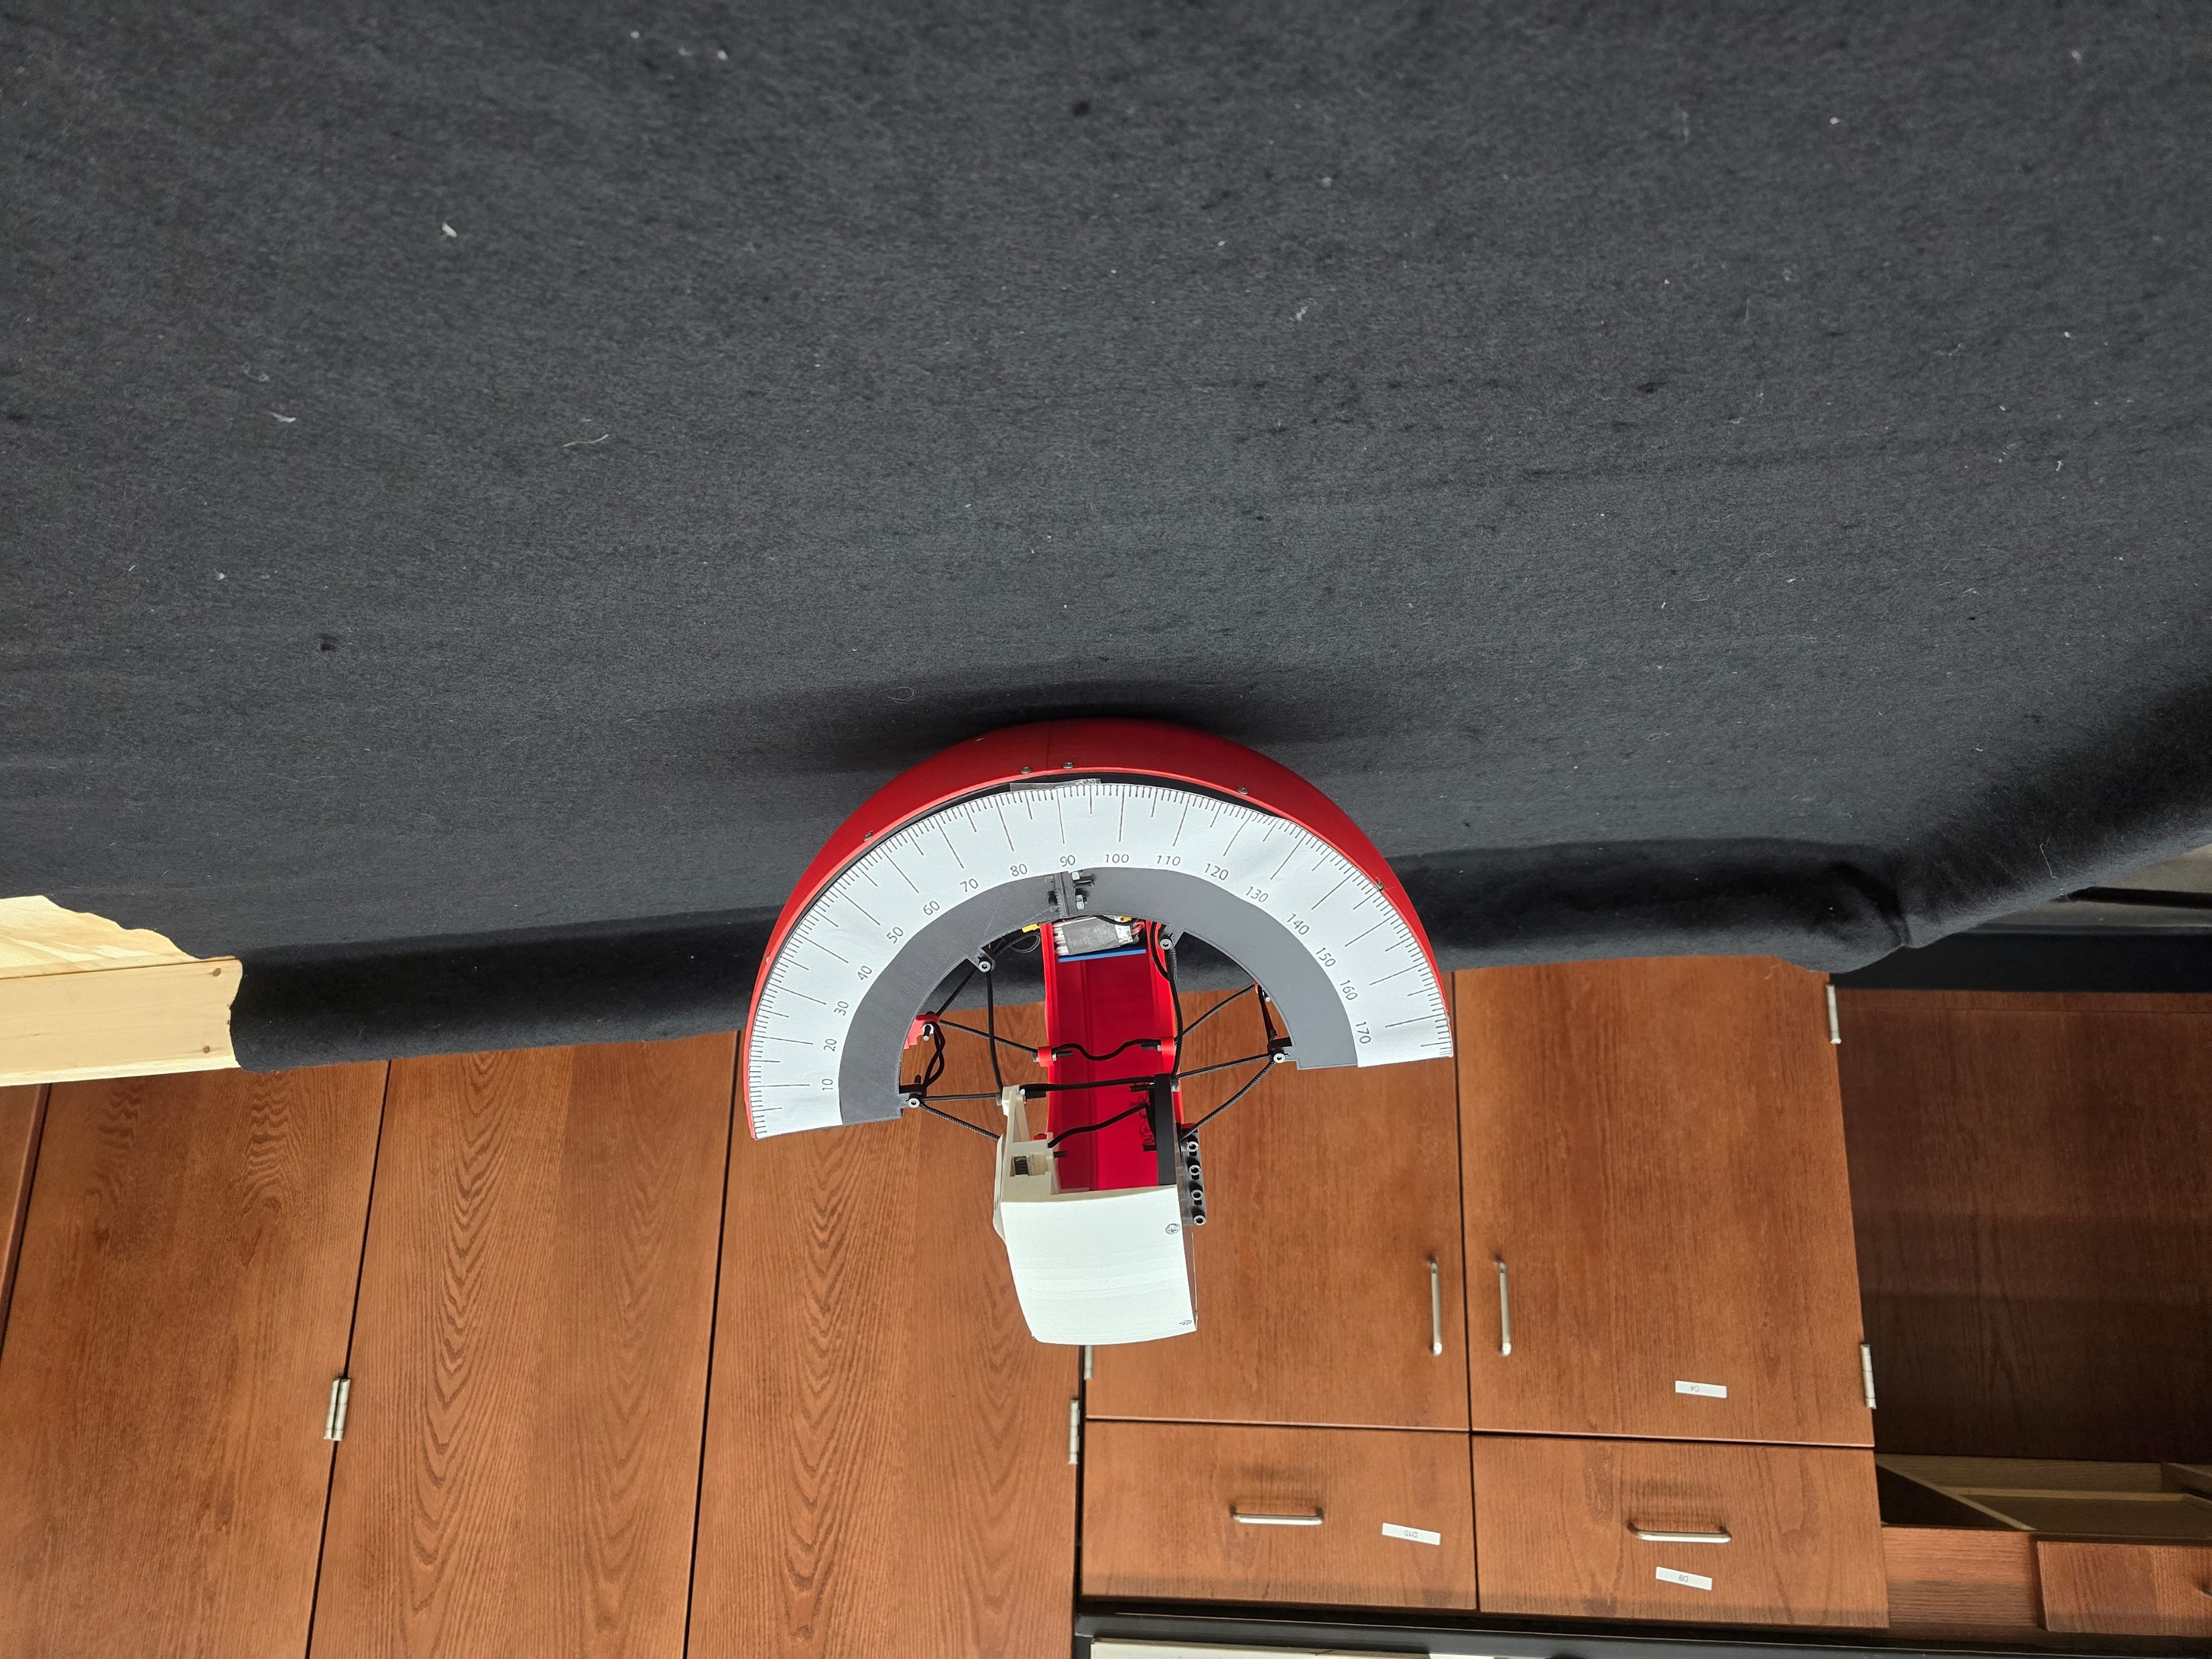
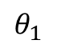

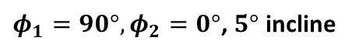
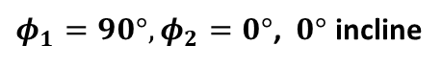



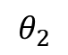
Experimental Validation
$$θ_{2}$$
$$θ_{1}$$
State 3, $θ_{1}=135°, θ_{2}=135°$
State 4, $θ_{1}=45°, θ_{2}=135°$
$φ_{1}=90°, φ_{2}=0°$, $0°$ incline
$φ_{1}=90°, φ_{2}=0°$, $5°$ incline
$$0°$$
$$5°$$

Slide 11

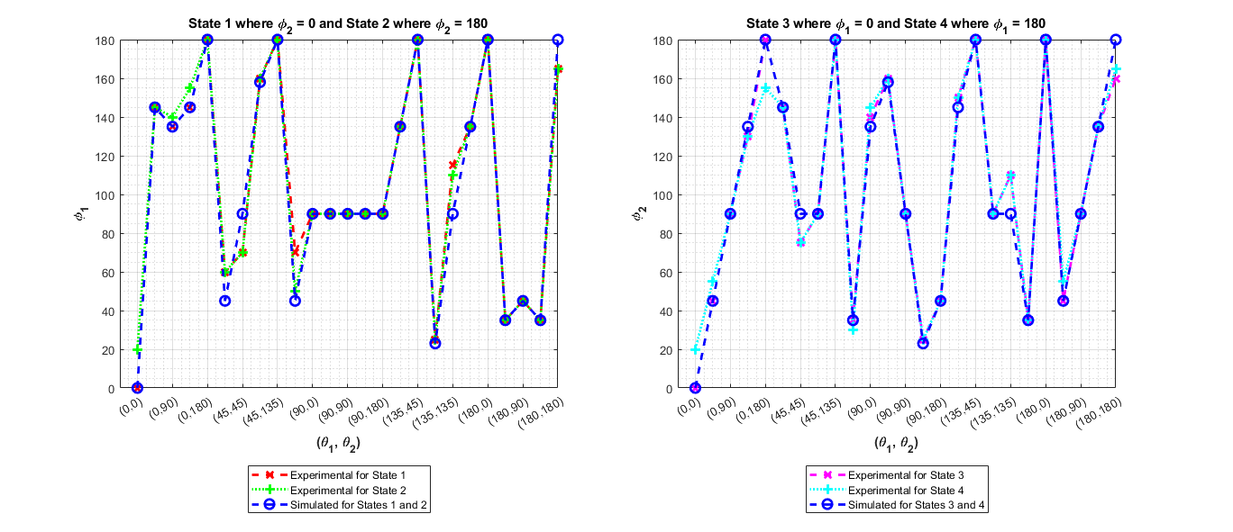
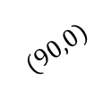
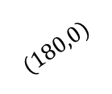
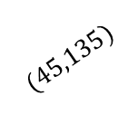
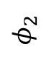
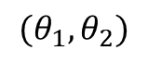
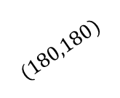
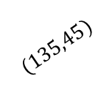
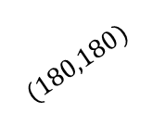
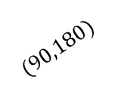
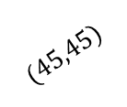
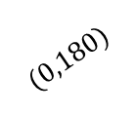
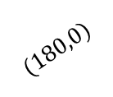
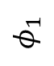
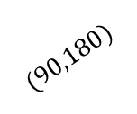


















Simulated vs. Experimental Results
𝑴𝑨𝑬 𝟒.𝟑𝟔°
State 1 where $φ_{2}=0$ and State 2 where $φ_{2}=180$
State 3 where $φ_{1}=0$ and State 4 where $φ_{1}=180$
$$180$$
160
140
120
100
80
60
40
20
0
$$180$$
160
140
120
100
80
60
40
20
0
$$φ_{1}$$
$$φ_{2}$$
$$(0,0)$$
$$(0,0)$$
$$(0,180)$$
$$(0,180)$$
$$(0,90)$$
$$(45,45)$$
$$(0,90)$$
$$(45,45)$$
$$(90,0)$$
$$(90,0)$$
$$(45,135)$$
$$(90,90)$$
$$(45,135)$$
$$(90,90)$$
$$(90,180)$$
$$(90,180)$$
$$(180,0)$$
$$(135,45)$$
$$(180,0)$$
$$(135,45)$$
$$(180,180)$$
$$(180,180)$$
$$(135,135)$$
$$(180,90)$$
$$(135,135)$$
$$(180,90)$$
$$(θ_{1},θ_{2})$$
$$(θ_{1},θ_{2})$$

Slide 12











Quasi-Static Simulations
$$x_{2}$$
$$x_{1}$$
$$x_{3}$$
$$x_{0}$$
$$x_{2}$$
$$x_{1}$$
$$x_{1}$$
$$x_{3}$$
$$x_{0}$$
$$x_{0}$$

Slide 13

Generalizable to Variable Morphologies
Shape morphing Number of curved links Curved link length

Slide 14
Takeaways and Research Impact
The paper statically models a mobile, curved-link tensegrity robot using a geometric representation and provides subsequent simulation and validation. The generalizable modeling framework is adaptable to robots with multiple points of contact and different morphologies;
The model analytically proves the hybrid nature of the system where the robot exists in four states. Each state corresponds to the motion where the robot instantaneously pivots about the end of one curved-link and rolls along the other;
Static simulations provide input-output relationship between the internal mass position and ground contact points, equivalently, the robot orientation;
A tetherless robot prototype experimentally validates the static model with high accuracy.

Slide 15

Questions?
L. Ervin and V. Vikas, "Geometric Static Modeling Framework for Piecewise-Continuous Curved-Link Multi Point-of-Contact Tensegrity Robots," in IEEE Robotics and Automation Letters, vol. 9, no. 12, pp. 11066-11073, Dec. 2024, doi: 10.1109/LRA.2024.3486199.

